Slide 1
PRESENT SIMPLE

Slide 2
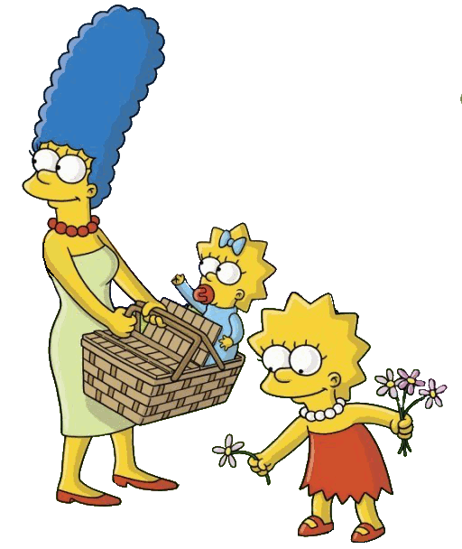
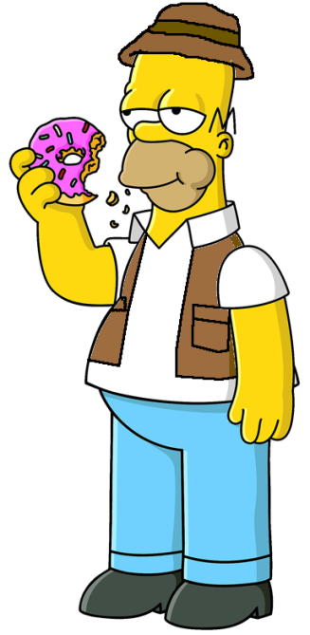
I am Bart.
I am with my family.
I’m American.

Slide 3
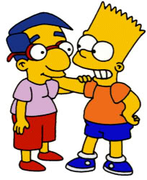
You are my friend.
You’re a good boy.

Slide 4
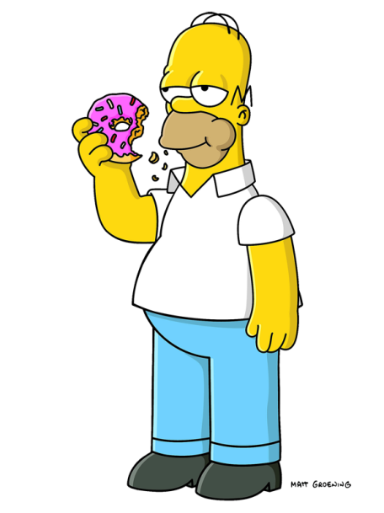
He is Homer.
He’s my dad.

Slide 5
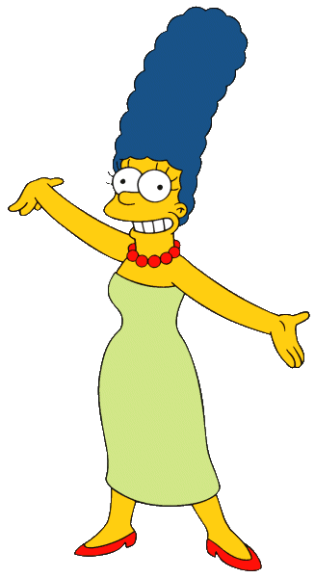
She is Marge.
She’s my mom.

Slide 6
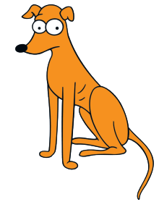
That is a dog.
It’s my pet.

Slide 7
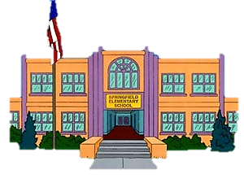
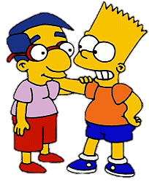
We are friends.
We’re at school.

Slide 8
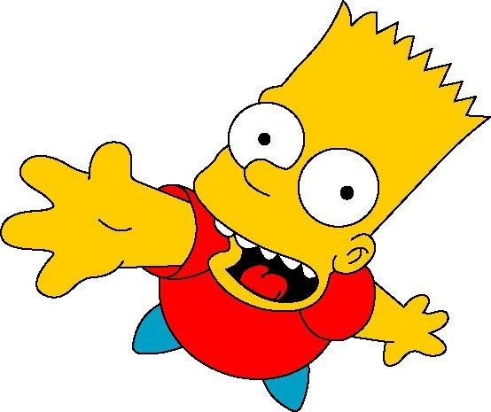
You and your friends are students.
You’re cool.

Slide 9
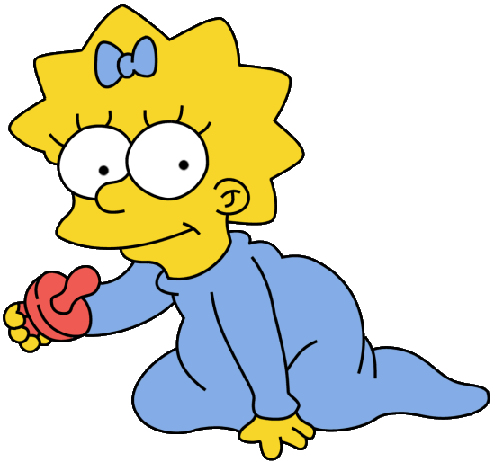
They are Lisa and Maggie.
They’re my sisters.

Slide 10
Long form Short form
I am
I’m
You are
You‘re
Remember
He is
He‘s
She is
She‘s
It is
It‘s
We are
We’re
You are
You’re
They are
They’re

